Slide 1

Using This Template
Please remove this slide from your final presentation.
This presentation is just a template; it is meant to be adapted for your context.
We have included a lot of slides, but we do not expect you to use all of them. Delete any slides and modify any content that is not applicable to your company.
We encourage you to brand this presentation to make it reflective of your company. This will also help the presentation become an asset that gets used in the future when presenting to other departments or new leaders in your organization.
If you have any feedback on this presentation, please submit it via our contact form on our website.

Slide 2
Purpose of This Presentation
Please remove this slide from your final presentation.
These are the outcomes that you can expect from your audience after having delivered this presentation.
Outcome #1
Outcome #2
Outcome #3
Your audience will walk away knowing what it means to be disability confident in the workplace. They will know the benefits of disability confidence and how it looks practically in your workplace.
Your audience will leave reflecting on where people with disabilities experience barriers in the workplace. They will be given a call to action to think about what this may look like in your work environment.
Your audience will leave knowing that accessibility and disability inclusion is a priority for your company.

Slide 3
Who Should My Audience Be?
Please remove this slide from your final presentation.
Disability Confidence should be introduced to all levels of your company, but it will look differently depending on everyone’s roles.
We recommend delivering it at different times tailored to the audience. You can divide it into the following groups:
  Executives and People Leaders
  Administrative and Operational Staff (i.e. finance, administration, legal, etc.)
  Frontline Staff

Slide 4

Do I Need to Be the Expert?
Please remove this slide from your final presentation.
No, a part of the disability confident approach is knowing when to say, “I don’t know” and being open and willing to learn and figure it out.
If your organization has the capacity to do so, you can reach out to our team about having someone facilitate this for your organization.
Do you have your Disability Confident Leader digital badge?
Complete our course to help you prepare for your work building a disability confident workplace.

Slide 5

What is AccessPath?
Please remove this slide from your final presentation.
Throughout this template you will see references to AccessPath or a self-directed assessment for measuring how accessible employment is at your business.
AccessPath is a free self-directed assessment that is available on Untapped Talent.
You will receive an overall score and scores in five specific areas.
Your responses are saved so you can update it over time to improve your score. Then when you do updates after this presentation or if you present it again in the future, you can show how your percentage has grown over time.
We highly recommend you complete this assessment for your business.

Slide 6
Do You Need More Support?
Please remove this slide from your final presentation.
Employers who are partnered with Untapped Talent have access to our exclusive version of this template.
What does exclusive include?
  Facilitator notes to help you present the information and engage your audience
  Additional statistics about disability and work
  Additional slides and guidance to help you outline your commitment
Speak with a member of our team to learn more: https://www.untappedtalent.ca/s/contact-us-form

Slide 7

Being a Disability Confident Employer
You can change our logo to be your own logo.
Understanding what it means to be an accessible and disability inclusive employer.

Slide 8

Agenda
Understanding Disability
Five Aspects of a Disability Confident Employer
How We Can All Contribute
Q&A

Slide 9

Understanding Disability
Disability is not just about medical conditions. Disability means a person faces barriers to fully participating. That means disability occurs when barriers in the environment interact with someone’s bodily condition.
Disabilities can be permanent, temporary, or episodic, and can be visible or invisible.
Barriers include physical, architectural, technological, attitudinal, information and communication barriers, and policies or practices that get in the way of equal participation.

Slide 10

A Broader Perspective
Historically, people have seen disability as an impairment that must be “fixed” or treated by medicine or healthcare professionals.
We view disability from a broader perspective – where disability exists because of the way that society is organized. If society was set up in a way that was accessible, persons with disabilities would not be prevented from fully participating.

Slide 11
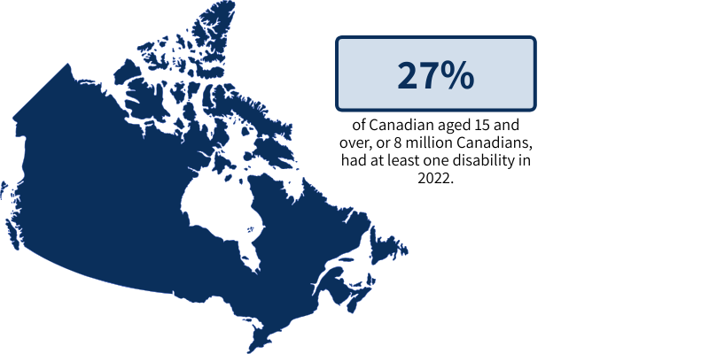
Rate of Disability Across Canada
Type of Disability | Prevalence
Mental Health Related | 10.4%
Pain-related | 16.7%
Seeing | 7.4%
Learning | 5.6%
Memory | 4.7%
Mobility | 10.6%
Flexibility | 10.9%
Hearing | 5.6%
Dexterity | 5.0%
Developmental | 1.5%
Unknown | 0.8%

Slide 12
Rate of Disability by Province and Territory
If your company is in one province or only specific ones, you should highlight the relevant rows by either making the text bold or changing the color of the cells.
Province | Prevalence
British Columbia | 28.6%
Alberta | 27.5%
Saskatchewan | 29.8%
Manitoba | 29.2%
Ontario | 28.0%
Quebec | 21.0%
New Brunswick | 35.3%
Nova Scotia | 37.9%
P.E.I | 31.8%
Newfoundland and Labrador | 30.9%
Nunavut | 19.3%
Northwest Territories | 25.7%
Yukon | 31.4%

Slide 13
Five Aspects of a Disability Confident Employer
1
2
3
4
5
Understands how disability reaches every aspect of its business
Learns directly from people with disabilities and puts what is learned into action
Identifies, addresses, and removes barriers for all people with disabilities
Provides accessibility supports to enable colleagues to fully contribute to the business
Does not make assumptions about what people can do based on any label

Slide 14
Does our business already meet these five expectations for a Disability Confident Employer?
Adjust the answer based on where your business is on their journey to being a Disability Confident Employer. One suggestion is that you say, we’ll demonstrate how our business meets each aspect on the following slides.
Another alternative of the slide is after this one, but you do not need to use both.
We may not meet each of the five aspects perfectly, but we are committed to disability confidence.

Slide 15
Does our business already meet these five expectations for a Disability Confident Employer?
This slide is an alternative to the one before it. This is based on the self-assessment for measuring the accessibility of employment in your business on your site. The assessment is called AccessPath. If you have completed it before your presentation, share your score. This way, as it improves, you can share it with everyone in status updates.
We completed a self-directed assessment on how accessible employment is at our business, our score was:
XX.XX%

Slide 16

Shared Responsibility
It is important for all levels of our company to work on their disability confidence.
Here are two common misconceptions about disability in the workplace, which results in attitudinal barriers:
People expect workers with disabilities to be unproductive.
People think providing accessible supports for workers with disabilities will cost a lot of money.
It is important to ensure that you are not currently buying into these misconceptions and that you understand what research shows us.

Slide 17

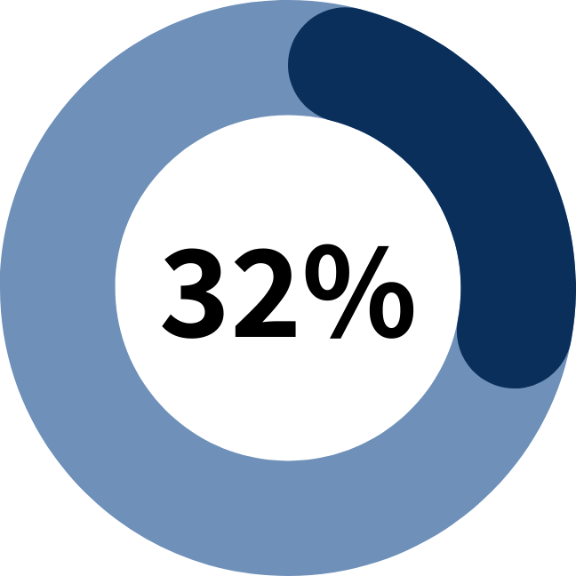
Myth: Workers with disabilities are unproductive.
Fact: There’s no data to support this claim. Especially because many workers with disabilities never disclose to their employer that they have a disability, so it is hard for someone to fairly estimate.
In 18 out of 31 organizations studied, there was no significant difference in productivity between workers with and without disabilities.
In 32% of the businesses, employees with disabilities were more productive.
Kaletta, J. P., Binks, D. J., & Robinson, R. (2012). Creating an inclusive workplace: Integrating employees with disabilities into a distribution center environment. Professional Safety: Journal of the American Society of Safety Engineers, 57(6), 62-71.

Slide 18
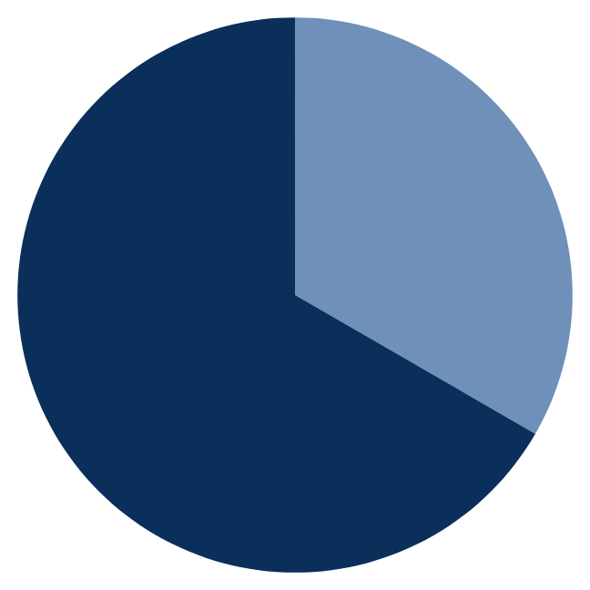
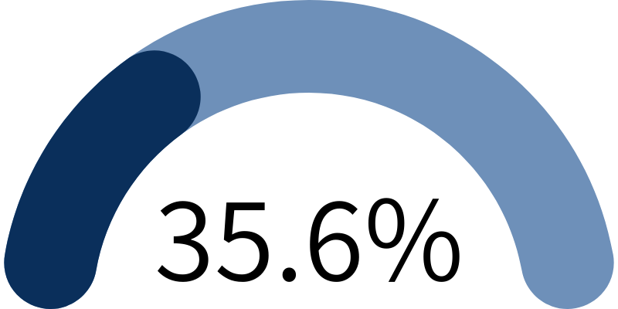
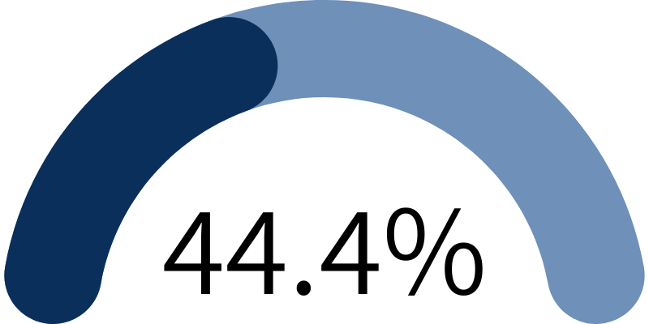
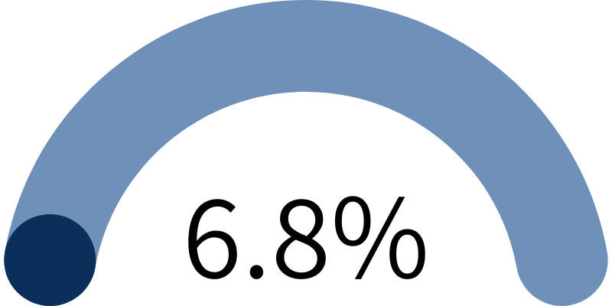
Myth: There’s a high cost to providing accessibility supports for workers.
$375
According to data from CCRW (ccrw.org), the average one-time cost of paid accessibility supports is about $375.
Nearly two-thirds of workers with disabilities require no accessibility supports (paid or unpaid) at all.
Over a third (35.6%) of paid accessibility supports cost less than $100.
Another 44.4% cost more than $100, but less than $500.
Statistics Canada says the most common workplace accommodation needs are:
Modified work hours
Modified duties
Working from home
Only 6.8% of accessibility supports cost $1000 or more.

Slide 19

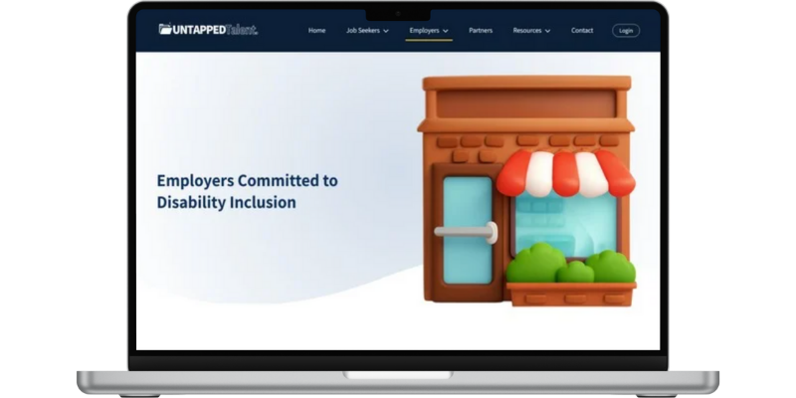
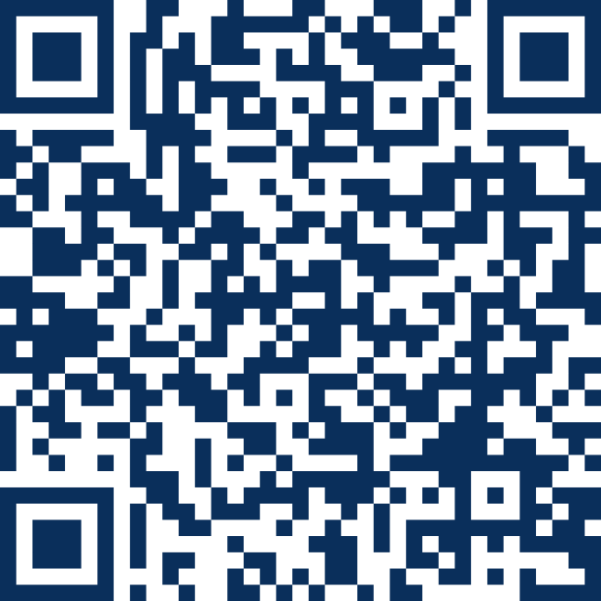

Build Your Knowledge
Use this as an opportunity to plug any upcoming webinars you’re hosting, training in your LMS, or community events that employees can participate in.
Another barrier to becoming a disability confident employer is people lack knowledge on disability and accessibility supports.
Scan to Follow
www.untappedtalent.ca
on LinkedIn
Visit Untapped Talent for information and resources. If you want to create an account with our company profile, contact [Company Contact] to receive an invitation to register.
Scan the QR code above to follow CCRW on LinkedIn. CCRW is always sharing resources and learning opportunities about disability and work.

Slide 20
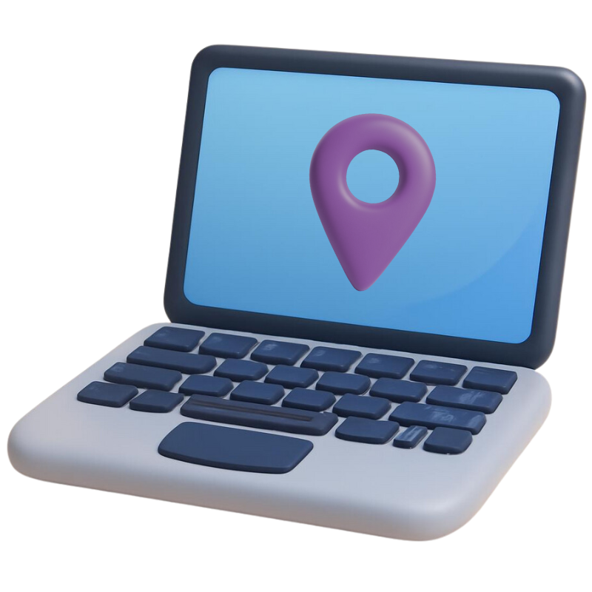
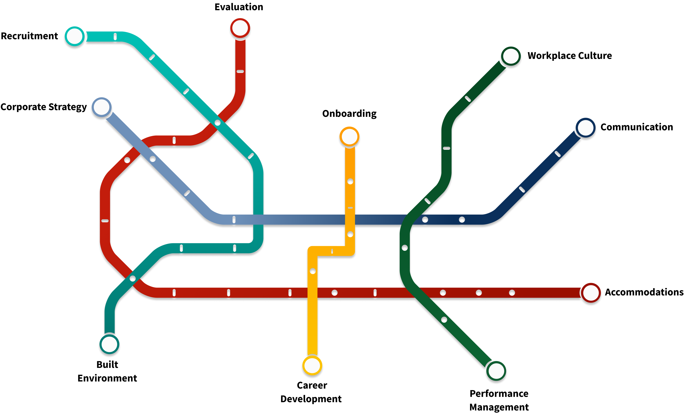
Disability Confidence Training
Get your digital badge today!

Slide 21

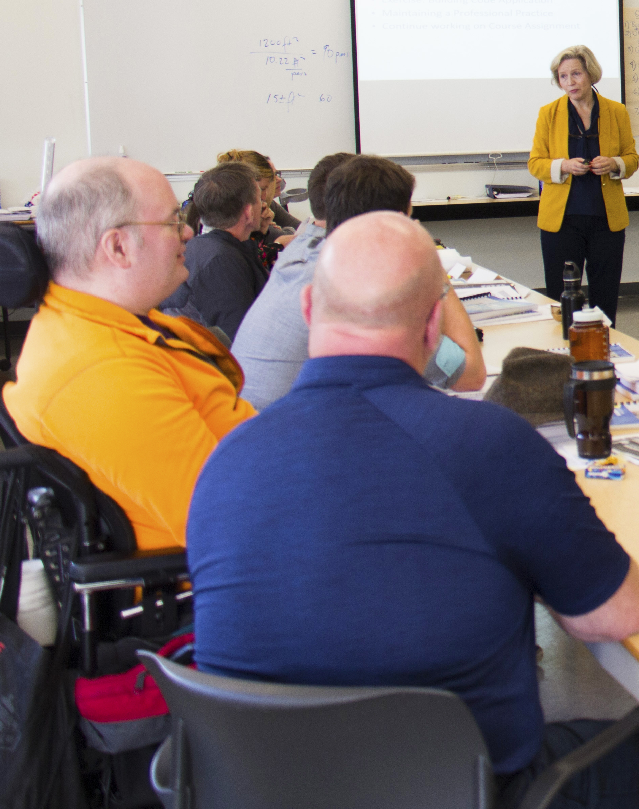

RHFAC Training
RHF Inclusion & Accessibility Training:
1-hour self-directed course designed to help organizations ignite positive change by making access and inclusion a cornerstone of their culture.
RHFAC Fundamentals Training:
An interactive 4-week self paced course, provides learners with foundational knowledge on how to make our physical spaces more accessible. No pre-reqs.
RHFAC Professional Training:
An 8-week online course, provides participants with the fundamental skills and knowledge required to rate a Site using the RHFAC methodology. Pre-reqs.
Learn more at RickHansen.com/Courses

Slide 22
Doing Our Part
As a company, we are committed to working towards the five aspects of a disability confident employer:
Understand how disability reaches every aspect of our business
Learn directly from people with disabilities and put what we learned into action
Identify, address, and remove barriers for all people with disabilities
Provide accessibility supports to enable colleagues to fully contribute to the business
Does not make assumptions about what people can do based on any label
Our Goals or In-Progress Initiatives To Help Us Get There:

Slide 23

Doing Your Part
We hope that you have reflected on the myths and that you take advantage of the learning opportunities.
Investing in your understanding and knowledge of disability in the workplace helps address some of the most common accessibility barriers in the workplace.
Our Last Call to Action for You is to Identify Any Barriers Related to Accessibility in Our Workplace
Send any suggestions or concerns you have to:
Name of Contact / Department
email@company.ca
(123)-456-7890

Slide 24
Questions?

Slide 25
Sources
https://social.desa.un.org/issues/disability/crpd/article-1-purpose
https://social.desa.un.org/issues/disability/frequently-asked-questions-faqs
https://www.laws-lois.justice.gc.ca/eng/acts/A-0.6/section-2.html
https://www150.statcan.gc.ca/n1/pub/11-627-m/11-627-m2023063-eng.htm
Kaletta, J. P., Binks, D. J., & Robinson, R. (2012). Creating an inclusive workplace: Integrating employees with disabilities into a distribution center environment. Professional Safety: Journal of the American Society of Safety Engineers, 57(6), 62-71.
https://toolkit.ccrw.org/wp-content/uploads/2023/04/CS_Tool-3_Starting-Your-Journey.pdf
https://toolkit.ccrw.org/wp-content/uploads/2024/07/CS_Tool1_Building-Your-Understanding.pdf
https://toolkit.ccrw.org/wp-content/uploads/2023/04/CS_Tool2_Identifying-the-Rationale.pdf
https://ccrw.org/wp-content/uploads/2024/11/Awareness-to-action-How-employers-can-embrace-disability-inclusion-in-the-workplace_CCRW_Trends-Report-2024.pdf
https://www150.statcan.gc.ca/n1/daily-quotidien/250210/dq250210c-eng.htm

